Slide 1
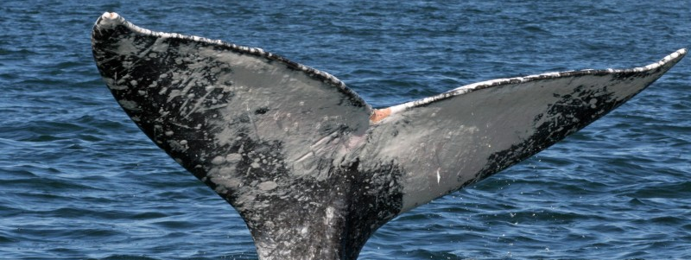
The Great Grey
Human Impact on the Migration Patterns of the Great Grey Whale
Notes:
Hi
My name
I have been researching the migratory patterns of the grey whales for a bit now as I realized that there could be an interesting correlation between the incidence of legislation and the actual number of whales spotted along the migration path of the grey whales.
I looked to surveys of grey whales from established sources, physical counts, for this exercise and used r and the tools in tableau for the analysis as these are frequency counts and trend analyses.

Slide 2
Background
 | Mara Talan is an avid environmentalist and spends much of her free time in open water.
 | Mara plans to work in the analytics & reporting space having previously served as a sales manager for custody reporting for large financial institutions where she focused on risk management, governance, and regulatory response solutions for government, central banks and other financial services organizations.
 | Mara received a Bachelor of Science in communications from the University of Texas at Austin
Notes:
I have been around a bit, having worked in sales and marketing for international banks for over 20 years out of New York. I have a BS from the University of Texas at Austin.

Slide 3
The thread to the threat
Original premise: How do variations in the population of grey whales correlate to changes in legislation? Can the change of approach in how whales are treated in one country impact levels of a species globally?
Variables observed: 1) When and where are the most whales observed? 2) During which months are juveniles observed? 3) How have numbers changed over the observation period? 4) Do the timeframes correlate to the changes in legislation?
Sources: North American Fisheries (NOAA), steven swatrz san ignacio ecosystem science program, www.vanqua.org, Western Gray Whale Map Period 10-04-2010 to 02-05-2011, www.acs-la.org
Notes:
It seemed like the more I pulled the more I unraveled, as I will share with you.

Slide 4
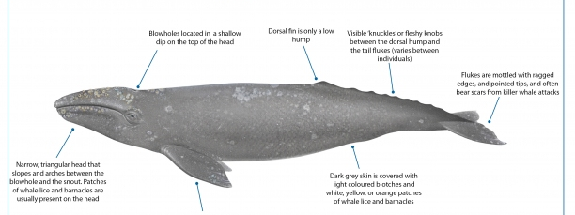
What does a grey whale look like?
Majestic
Notes:
Key to understand/ whales weigh
Length
Calf
Head slope and arches between blowhole and the snout, behind the head is the blowhole
Grey skin, light colored blotches, White, yello, Orange patches
Fluke mottled with ragged edges and often bear scars from killer whale attack and fishing boats
On its back, knuckles and flesht knobs, the tal flukes are identifiers, like id cards
The dorsal fin is a small hump
Why is this important

Slide 5
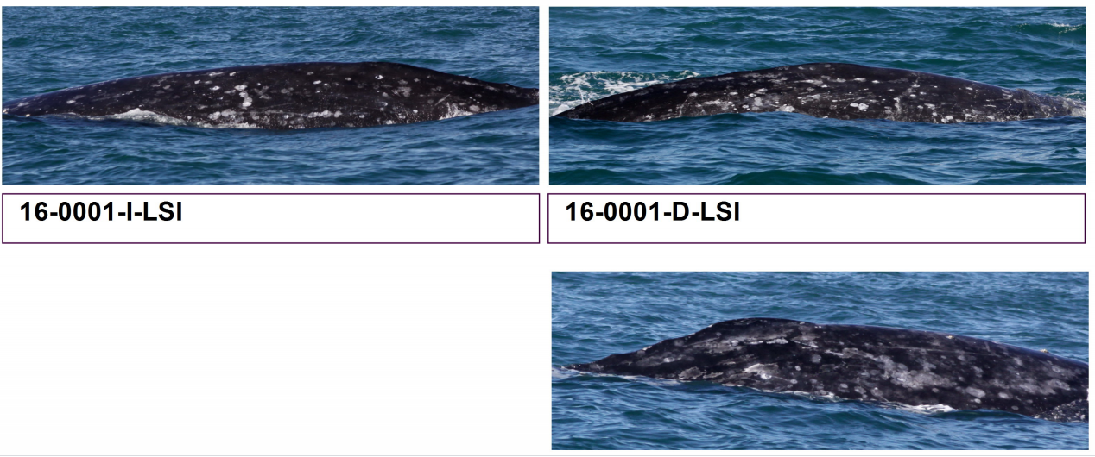
Examples of grey whale catalog
Photographic Identification is one of the most powerful tools available to researchers at the San Ignacio Ecosystem. Gray whales have distinctive markings on their backs and flukes that change very little as they grow and help researchers distinguish them as they go back to the mating grounds year after year, even if they acquire white scars from injuries, barnacles, and killer whale tooth “rake marks”.
Whales are catalogued and these records are public.
Notes:
Scientists track the back knuckles, visible knobs and blotches, the scars and flukes to determine identity.
It is that distinctive, no two whales are exactly alike.
It is also how we know how many are out there, and how many are not making the trip back.

Slide 6
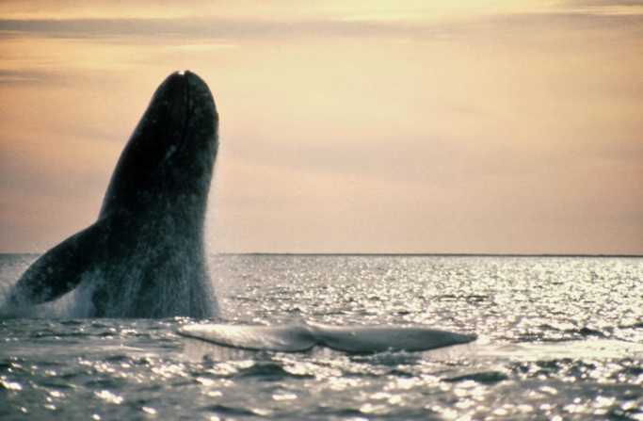
Migratory Pattern

Slide 7
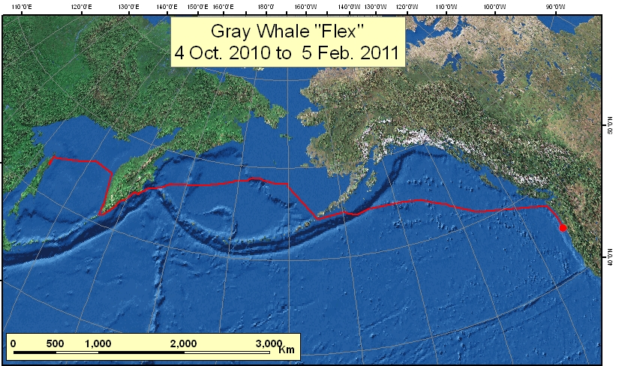
Each year around October the gray whales in and around the eastern pacific Alaskan waters begin their migration trip from their feeding grounds to their mating grounds around the Baja peninsula of Mexico and the southern Gulf of California, as much as 14,000 miles.

Slide 8
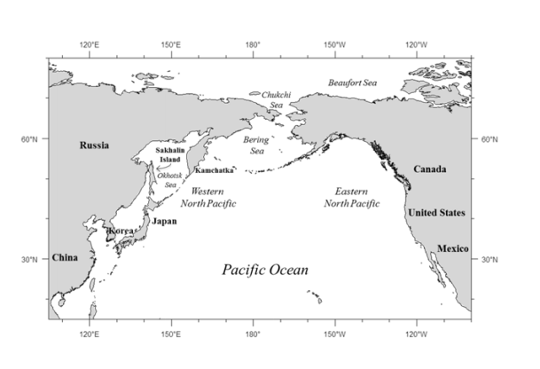
Each year around October the gray whales in and around the eastern pacific Alaskan waters begin their migration trip from their feeding grounds to their mating grounds around the Baja peninsula of Mexico and the southern Gulf of California, as much as 14,000 miles.
https://mmi.oregonstate.edu/wtg/research-projects/gray-whale/western-gray-whale-map-period-10-04-2010-02-05-2011

Slide 9
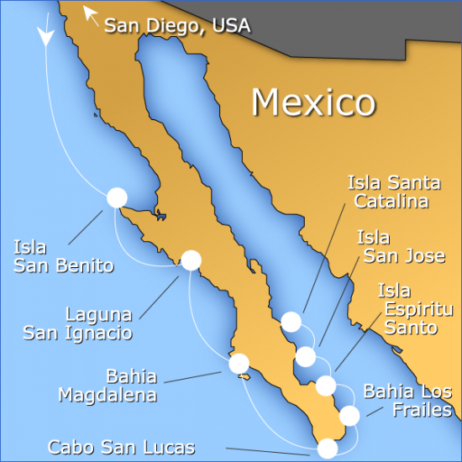
Where does the migratory path end?
Grey whales give birth in the Sea of Cortez, so counting whales and calves in the peninsula is of prime importance to the health of the grey whale population.
We will compare data highlighting periods of landmark legislation for impact on the migration of the grey whale.
The pregnant females are often the first whales to arrive at the mating grounds
Non pregnant but fertile females may also be found arriving early to look for an eager mating partner
By mid February to March, most of the population can be seen mating, socializing and giving birth at the mating grounds.
Throughout March gray whales that have finished mating may begin traveling back towards their feeding grounds in the eastern pacific with pregnant mothers and females that have just given birth staying behind until mid April to May before leaving.
Focus of the data: Adult greys and juveniles for the periods: February through May 2010-2016
Japan passed landmark legislation allowing hunting in 2014.

Slide 10
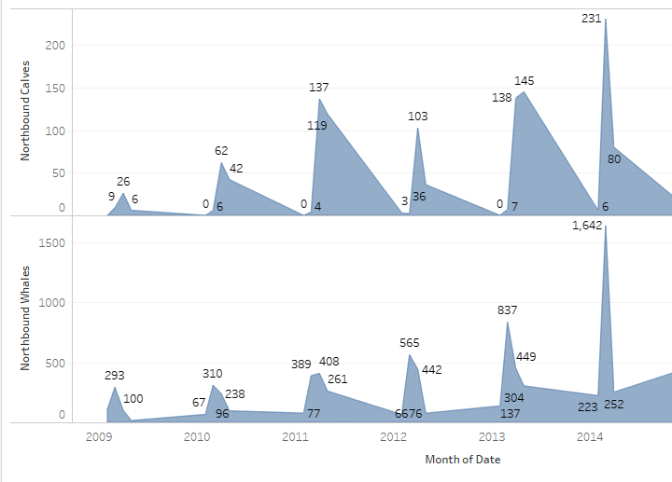
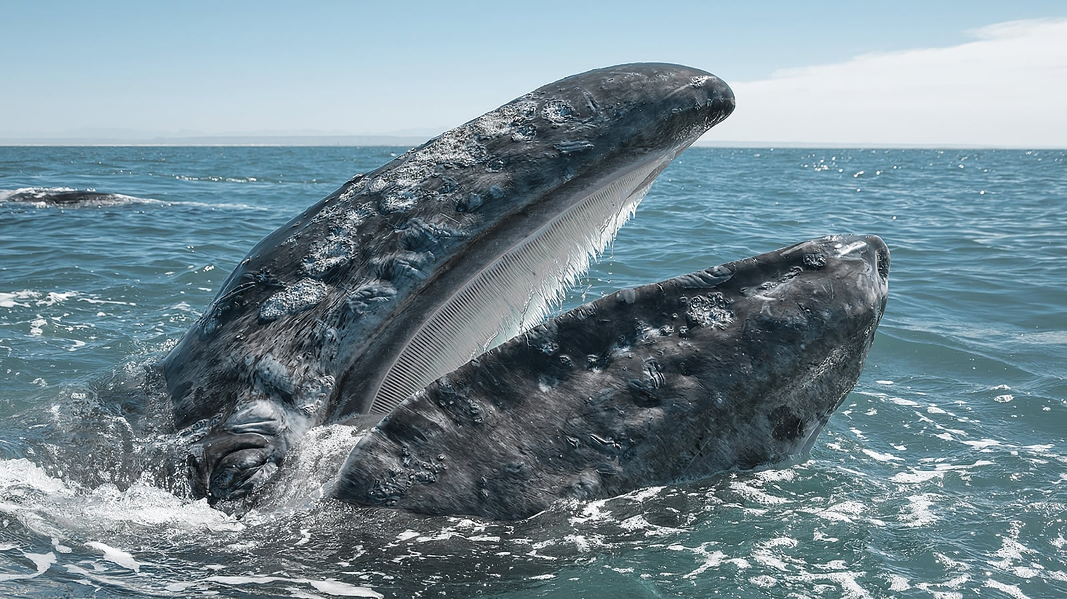
Sightings Tracking yoy 2009-2014
https://journeynorth.org/gwhale/data_la.html

Slide 11
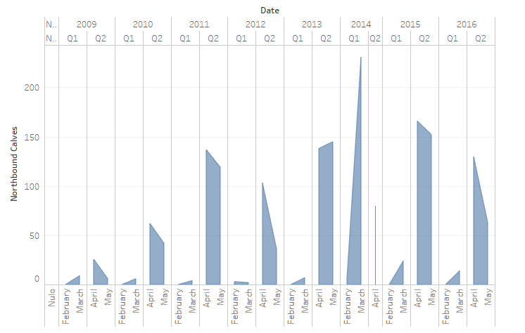
Calves peak and decline

Slide 12
Grey whale estimated annualized population
https://www.sanignaciograywhales.org/

Slide 13
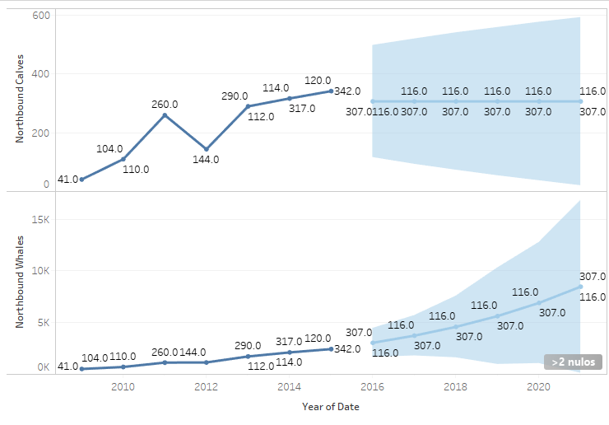
Forecast- trend

Slide 14
Legislation- the case of japan
In practice
Legislation
Japan's Antarctic whaling program was declared illegal by the UN Court of Justice on 31st March 2014. It had been actively ´researching´ in international waters.
Until this recent announcement Japan used the loophole of 'scientific whaling' to side step the IWC ban and the meat is sold on the open market.
On December 26th 2018, Japan announced it would resume commercial whaling in July 2019. On July 1st, whalers set sail to hunt 52 minke whales, 187 Bryde's whales and 25 sei whales.
Figures from Japan's whaling expedition to Antarctica during 2017/18 reveal that 122 out of the 181 female minke whales killed were pregnant.

Slide 15
Fisheries and the IWC
Congestión and Feeding Areas
WNP and ENP
Near shore industrialization and shipping congestion
Exposure to pollutants
Ship strikes as well as a general degradation of the habitat
Migratory routes of these whales at risk
Operations of this nature have introduced new sources of underwater noise, including seismic surveys, increased shipping traffic, habitat modification, and risks associated with oil spills (Weller et al. 2002).
The decline of gray whales in the WNP is attributable to commercial hunting off Korea and Japan between the 1890s and 1960s.
The pre-exploitation abundance of WNP gray whales is unknown, but has been estimated to be between 1,500 and 10,000 individuals
By 1910, it is estimated that only 1,000 to 1,500 gray whales remained in the WNP population (Berzin and Vladimirov 1981).
Between 2005 and 2007, four female gray whales (including one mother-calf pair and one yearling) died in fishing nets on the Pacific coast of Japan.

Slide 16
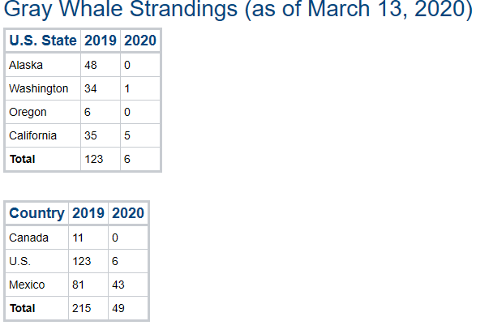
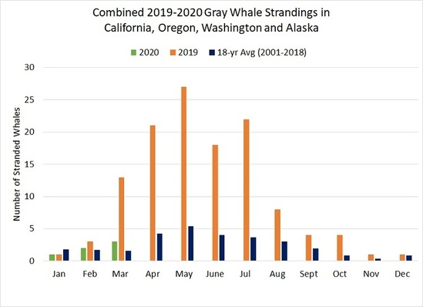
Unexpected impact/ Emanciation
Unusual Mortality Event

Slide 17
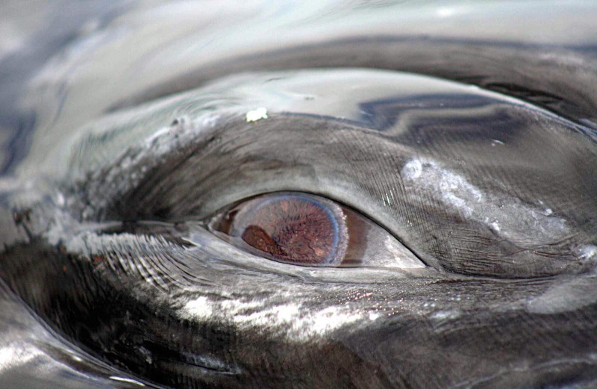
Climate change- Greys are a barometer
In San Ignacio Lagoon, scientists typically see at least 75 mother-calf pairs each year. In 2019, they saw only about 40. Calf sightings typically peak in March and early April.
We have much to learn about the small crustaceans gray whales rely on for food. However, declines in Arctic sea ice or other ecological changes could be making prey more scarce and causing UMAs.
Notes:
ENP gray whale population is now responding in several ways to environmental changes & possible over utilization and decline of its primary food resources, and the potential influence of human activities to these responses:
Conclusions
Increased pressure from fisheries/ hunting and nets
Reduction in the production of calves
Changes in the timing of migration and distribution of ENP gray whales on the winter breeding range
Environmental changes
All impact the grey whale

Slide 18
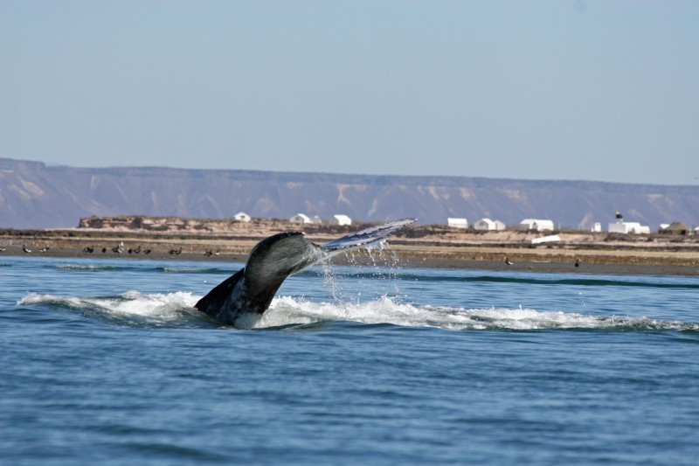
Thank you

